Slide 1
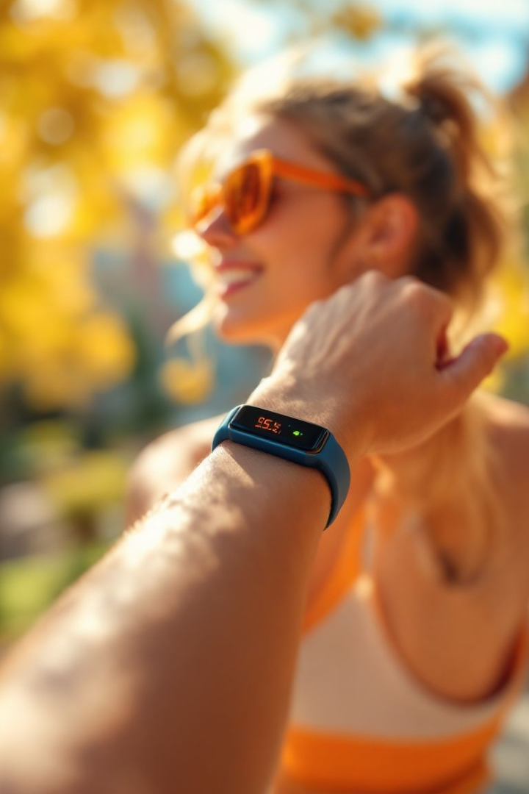

Personal Fitness Tracker: Python Edition
This presentation introduces a personalized fitness tracker built with Python. It leverages data analysis for customized health insights. The tracker uses BMI, exercise, walking time, weight, and temperature as inputs. It provides tailored recommendations for every age group to promote fitness and well-being.
by Akula Vamsi krishna

Slide 2
Core Functionality: Data Input and Processing
Data Input
BMI Calculation
Temperature
Our tracker uses Python libraries like Pandas and NumPy. Input methods include manual entry and wearable device integration.
BMI = weight (kg) / [height (m)]^2
Normal body temperature range: 97°F (36.1°C) to 99°F (37.2°C).
Healthy range: 18.5 - 24.9
Overweight: 25-29.9
Obese: 30+

Slide 3





Personalized Output: Fitness Insights
Calorie expenditure
Ideal walking time
Healthy temperature
Resting heart rate
Estimated calories burned during exercise (MET values).
Recommends 150 minutes/week of moderate intensity walking.
Suggests hydration and appropriate clothing to maintain body temperature.
Alerts if resting heart rate spikes above 100 bpm during rest.

Slide 4

Age Comparison Module: "Age-alyzer"
Peer Comparison
Functional Age
Compares fitness levels to peer groups using anonymized data.
Example: "You are functionally 9 days younger/older than Ram."
Statistical Analysis
Uses data normalization and statistical analysis for accurate comparisons.

Slide 5

Code Example: BMI Calculation in Python
def calculate_bmi(weight_kg, height_m): bmi = weight_kg / (height_m ** 2) return bmi weight = 70 height = 1.75 bmi = calculate_bmi(weight, height) print(f"Your BMI is: {bmi}")
The code snippet above shows a basic BMI calculation function in Python. It takes weight in kilograms and height in meters as inputs. Then, it returns the calculated BMI value.

Slide 6





Future Scope and Development
AI Integration
Incorporate AI for predictive health analysis and personalized workout plans.
Enhanced Integration
Expand compatibility with various wearable devices and health platforms.
Detailed metrics
Include advanced metrics: VO2 max, metabolic rate, sleep quality etc.
Targeted advice
Offer personalized health advice based on age, gender, and health conditions.

Slide 7

Conclusion: Your Path to a Healthier Life
This personal fitness tracker is designed to improve fitness and promote a healthy lifestyle. It offers personalized insights and recommendations for users of all ages. Stay healthy by taking control of your fitness journey.

